Slide 1



DEPARTMENT OF ELECTRONICS AND COMMUNICATION ENGINEERING MINOR PROJECT 3 FINAL REVIEW ACCIDENT PREVENTION BY HEAVY VEHICLE
PRESENTED BY:
NITHISHKUMAR C [927621BEC140]
GUIDED BY:
Mrs.M.SENTAMILSELVI
Assitant professor

Slide 2
Abstract
This project aims a concept of Navigating through one way can be challenging and risky, especially when drivers can’t see past big vehicles before overtaking. In our project we decided to tackle this problem head-on and came up with a neat solution. This innovative technology makes it much safer for drivers to pass a vehicle without the fear of oncoming traffic with a wireless camera installed in the front and display the live action to the backside of vehicle’s Screen and creating a see-through effect, to prevent road accidents. The vehicle is a simple and neat solution to limit accidents and prevent collisions caused by sudden braking or overtaking the vehicles. In this project we developed a Prototype that the vehicle is controlled by Bluetooth. An android application which is used to control the vehicle. The movement of the vehicle is facilitated by the Four Gear motors connected with microcontroller at the receiver side.
Keywords: Bluetooth, Automation, overtaking, microcontroller.

Slide 3
Introduction
Road Transport is the primary mode of transport which plays an important role in conveyance of goods and passengers and linking the centers of production, consumption and distribution.
The road transportation increases year by year, but the rate of road crashes also increases with it.
India is one of the developing countries, where the rate of road crashes is more than the critical limit.
Road accidents are a human tragedy, which involve high human suffering. They impose a huge socio-economical cost in terms of untimely deaths, injuries and loss of potential income
The huge number of injury and death due to road traffic accident reveals the story of global crisis of road safety.
Road collisions are the second leading cause of death for people between the ages of 5 and 29 and third leading cause for people between 30 and 44

Slide 4
Problem Statement
Road accidents are one of the most relevant problems in today's humanity. Every year 1.24 million people die in road accidents around the world. Road traffic injuries are the leading cause of death among young people, aged 15–29 years. Half of those dying on the world’s roads are “vulnerable road users”: pedestrians, cyclists and motorcyclists. Road accidents not only impose huge economic losses representing between 1-3 % of annual Gross Domestic Product in most countries but also causes great emotional and financial stress to the millions of families affected. India is the developing country, and the Highways are the most vulnerable places for the occurrence of the accidents

Slide 5
OBJECTIVE
To Analyze Road accidents and identify black spots based on accident occurrence rate on the study area.
To Develop Road accidental model.
To Propose Suggestions for reducing the occurrence rate and severity index of Road accidents on study area

Slide 6
LITERATURE SURVEY
With the number of vehicles rapidly rising in developing countries, this epidemic is quickly worsening in low and middle-income countries and is on its way to becoming the third leading cause of death and disabilities by the year 2020 (WHO 2000). The loss in road traffic accidents enormous in economy and health related issues. Low and middle income countries suffer from significant percentage of preventable deaths and injuries from road collisions in these countries.
Review of The Effect of Traffic and Weather Characteristics on Road Safety. Despite the existence of generally mixed evidence on the effect of traffic parameters, a few patterns can be observed. For instance, traffic flow seems to have a nonlinear relationship with accident rates, even though some studies suggest linear relationship with accidents

Slide 7
EXISTING METHOD
The traffic accidents are among the highest in the world, with most of these accidents occurring on two-lane roads and particularly in situations of overtaking. With this in mind, we develop a technology for trucks that seeks to enrich the lives of people through innovation. But more than that, this time the goal is more ambitious to save lives.
Anyone who has driven for very long knows the frustrations of being stuck behind a truck on a two-lane road. You can’t see around it, and crossing the centerline to peek around seems like you’re taking your life into your own hands. Hampered by a lack of visibility around the back end of larger trucks, drivers often make risky maneuvers that could result in serious head-on collisions with approaching traffic. Driving at night or in bad weather can increase the risk of a crash.

Slide 8
NEW METHOD
The vehicle consists of a wireless camera attached to the front of the truck, which is connected to a video wall made out of four exterior monitors located on the back of the vehicle. The monitors give drivers behind the vehicle a view of what is going on ahead, even in the dark of night.
This allows drivers to have a better view when deciding whether it is safe to overtake. Another advantage of the Safety Truck is that it may reduce the risk of accidents caused by sudden braking or animals crossing the road.
As creative uses advance with technology development, video walls are becoming an even more powerful tool in stationary places, giving businesses a new way to break through clutter and engage with a video-friendly audience in myriad environments.

Slide 9
COMPONENTS REQUIRED
Gear Motor
Wheels
Arduino UNO Board
L298D Motor Driver
HC05 Bluetooth module
Android App Developed – AMR_VOICE

Slide 10
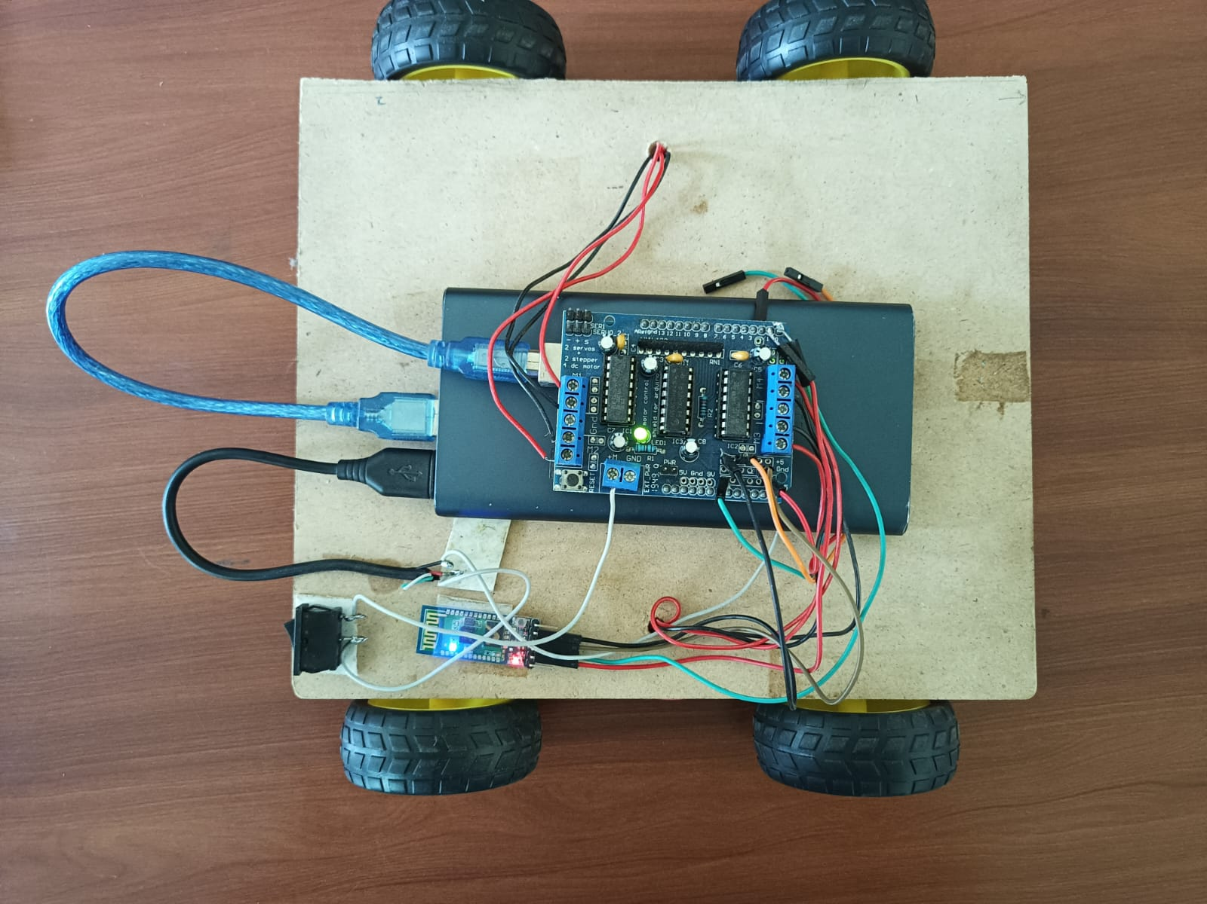
RESULT

Slide 11
CONCLUSION
The goal of this project is to develop a It can be difficult and dangerous to navigate via one way, particularly when drivers can't see past large trucks before passing. In our project, we made the conscious decision to address this issue head-on and developed a clever solution. With a wireless camera put in the front and displaying the live action on the rear of the vehicle's Screen and producing a see-through effect, this cutting-edge technology makes it much safer for drivers to pass a vehicle without the fear of approaching traffic, helping to prevent traffic accidents. The car is an easy and practical way to reduce crashes and accidents brought on by sudden braking or passing other vehicles.

Slide 12
REFERENCE
M. Meghana et al,2020, Hand gesture recognition and voice controlled robot, Materials Today: Proceedings, 2214-7853.
M.Bhanu chandu, Kirupa Ganapathy,2020, Voice Controlled Human Assistence Robot, International Conference on Advanced Computing & Communication Systems (ICACCS), 978-1- 7281-5197-7/20.
P. Mahesh Reddy, Suram Pavan Kalyan Reddy, G R Sai Karthik, Priya B.K,2020, Intuitive Voice Controlled Robot for Obstacle, Smoke and Fire Detection for Physically Challenged People, International Conference on Trends in Electronics and Informatics (ICOEI ), ISBN: 978-1-7281- 5518-0.
Ass. Prof. Emad S. Othman, Senior Member IEEE - Region 8, 2017, Voice Controlled Personal Assistant Using Raspberry Pi, International Journal of Scientific & Engineering Research Vol 8, Issue 11, 1611, ISSN 2229-5518,pp1611-1615.

Slide 13
Harshada Rajput, Karuna Sawant, Dipika Shetty, Punit Shukla, Prof. Amit Chougule, 2018, Voice- Based Home Automation System Using Raspberry Pi, International Research Journal of Engineering and Technology (IRJET), pp1154-1156
Abikshit Timsina, Dev Chandra Sharma, Nirmala Sharma, Allen Bhutia, Sujala Pardhan , 2020, Voice Command Robotics Car, International Research Journal of Modernization in Engineering Technology and Science, Volume:02/Issue:06/ e-ISSN: 2582-5208.
Piyare, R. and Tazil, M., “Bluetooth based home automation system using Android phones”. IEEE 15TH International symposium on consumer electronics (ISCE), 14-17 June 2011, Singapore

Slide 14
THANK YOU

